Slide 1

Introduction To ERP
By Jheanelle Soyibo
Notes:
Welcome to CRM Training.
We here at Virtual Stacks use an in – house software that we use to manage our daily interactions with our customers and potential customers.

Slide 2
Overview
About eZnet ERP
Logging In
CRM Module
Lead, Opportunity, Customer and Ticket
Calendar
Quotes
Sales Module
Create a Sales Quote and Sales Order
Notes:
We are going to cover the modules that you will be utilizing the most. After you have mastered these modules, feel free to explore around the ERP/CRM , given that you have the proper permissions to do so.

Slide 3
About eZnet ERP
eZnet ERP is our in-house enterprise resource planning software used to organize , store and manage data.
It is used to keep track of customers and transactions.
Notes:
You will use the ERP to gather, store and manage the information of your customers. Each transaction such as the billing ,quotes, sales orders and quotes.

Slide 4
Logging In
Click here to log in to eZnet ERP
If at any time you are experiencing technical difficulties with the eZnet ERP,
email : support@virtualstacks.com
Notes:
Check for login credentials – go to http://66.55.11.23/erp/admin/index.php?c=&ref=crm/home.php
Ensure everyone can log in

Slide 5
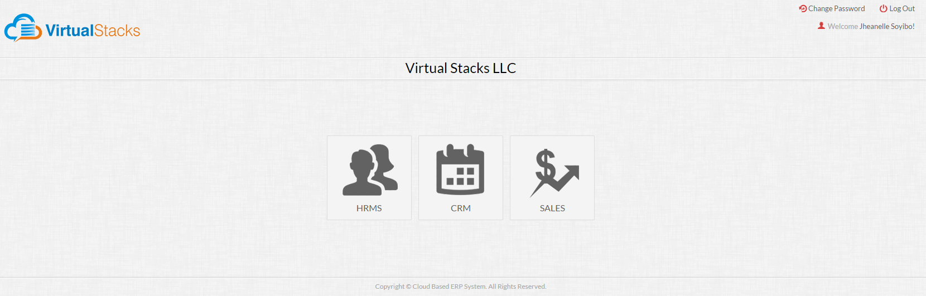
Main Menu
FOR TRAINING USE ONLY
Notes:
If your log in was successful, you will see these three modules, if you do not have see all three, let me know right now, so we can get you started. You may reference this slideshow in the future for any clarification.

Slide 6
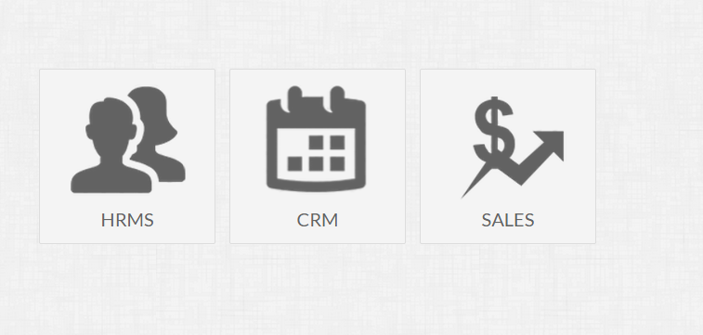
CRM Module

Slide 7
Lead
Opportunity
Customer
Ticket
Calendar
Quotes
CRM Modules
Notes:
In the CRM section of the ERP, these are the modules that you will use frequently. Lead, Opportunity, Customer, Ticket, Calendar and Quotes. I’m going to explain how each plays a vital part in the Sales structure.

Slide 8



Actions Icons
View
Edit
Delete

Slide 9
Leads
Leads are possible customers that may have interest in the product/service that your business offers.
Notes:
The Lead is the first stage of the sales structure. Every potential customer starts out as a lead then their status gradually changes with each milsetone.

Slide 10
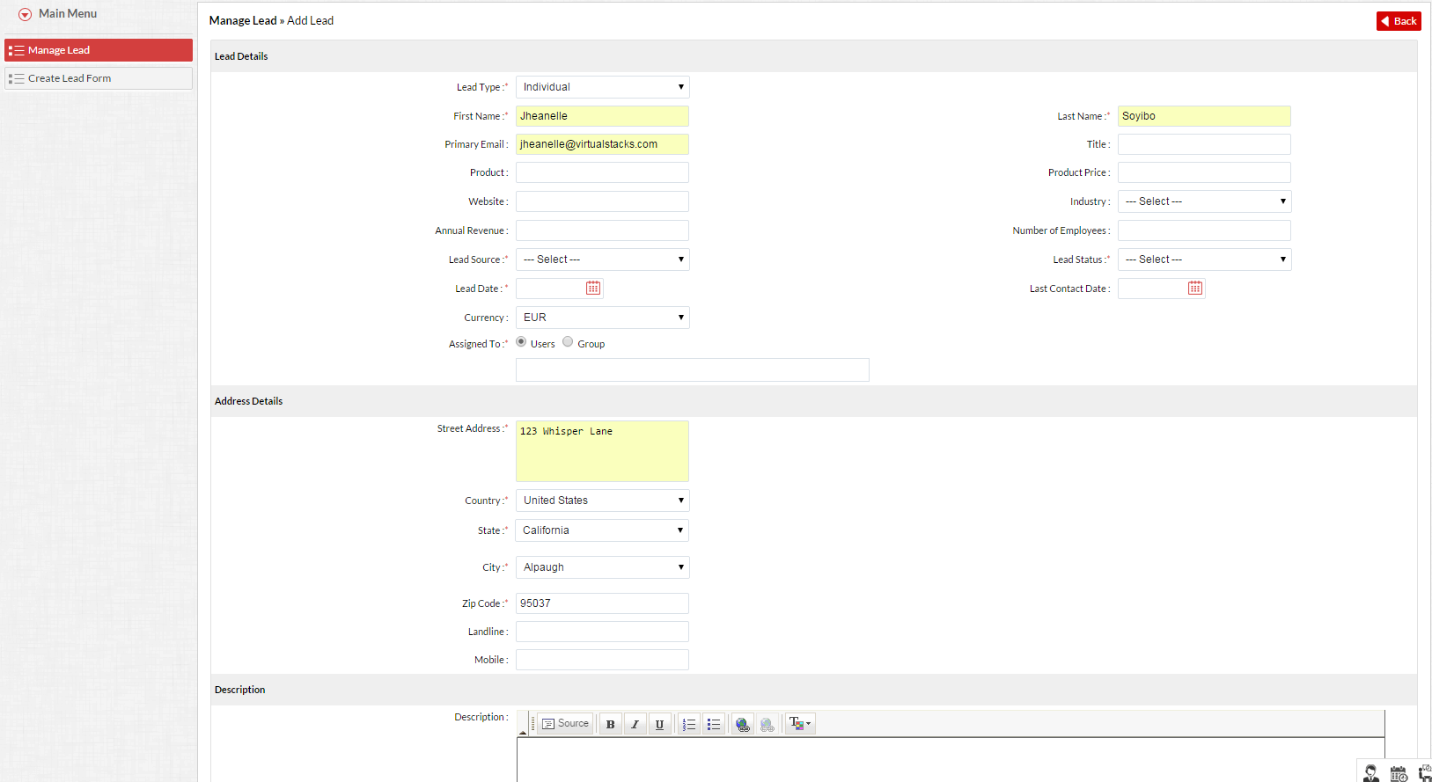
Add Lead
FOR TRAINING USE ONLY
Notes:
To add a lead, proceed to the Lead Module and input the mandatory information indicated by an asterisk. If you selected submit and didn’t complete the mandatory fields, the system will notify you.

Slide 11
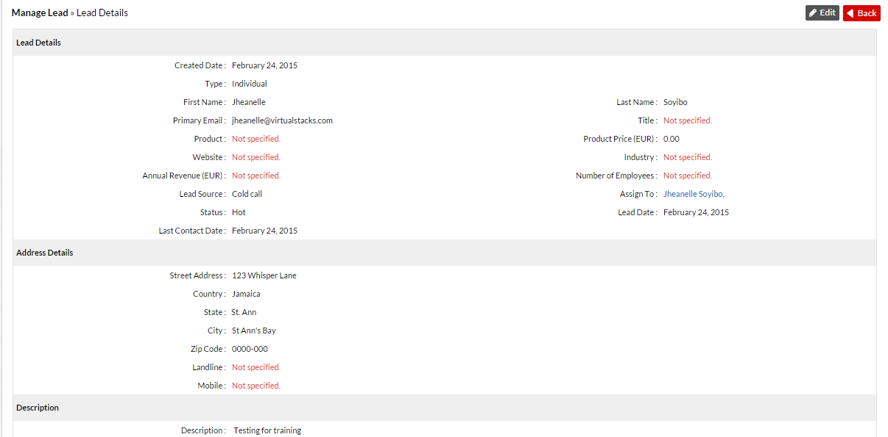
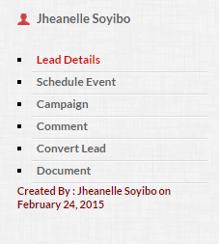
Add Document & Event to Lead
FOR TRAINING USE ONLY
Notes:
When you have successfully added a lead, you may add more details to this file to keep updated on everything related to this lead in particular. You many add an event, campaign, additional comments and documents. If you proceed to view the lead that you recently created, on the right- hand side of the window , you will see a window. For the Sales Portion of you will only

Slide 12
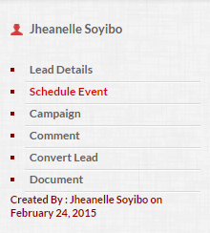
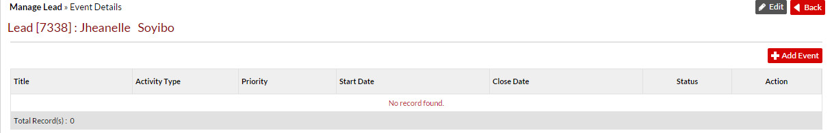
Add Event to Lead
Select “Schedule Event” to organize an event related to that Lead.
FOR TRAINING USE ONLY
Notes:
Select “Add Event”

Slide 13
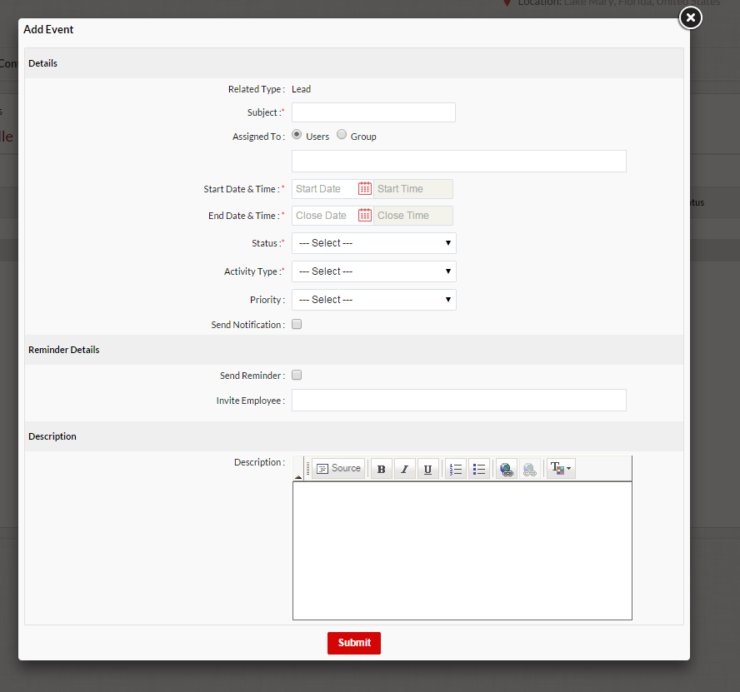
Add Event to Lead
Input the necessary information indicated by an asterisk.
All scheduled events are located in the Calendar module.
FOR TRAINING USE ONLY
Notes:
After filling out the information, the event is saved in both the Lead and Calendar Module.

Slide 14
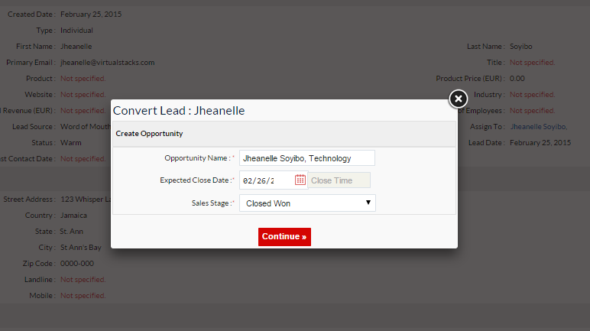
Convert Lead to Opportunity
FOR TRAINING USE ONLY
Notes:
Let’s say you have a existing lead, and that specific individual wants to continue to conduct business with you. Under these circumstances, you would convert their status into an Opportunity. We name the Opportunity: First Name, Last Name and Industry Type. After selecting “Continue” the Lead will be listed under Opportunity.

Slide 15
Opportunity
Second stage of the customer relationship. A LEAD is converted into an OPPORTUNITY when the potential customer has shown interest in your product/service.
Notes:
Every Opportunity starts out as a Lead. And given favorable circumstances, they will eventually be converted to an active customer.

Slide 16
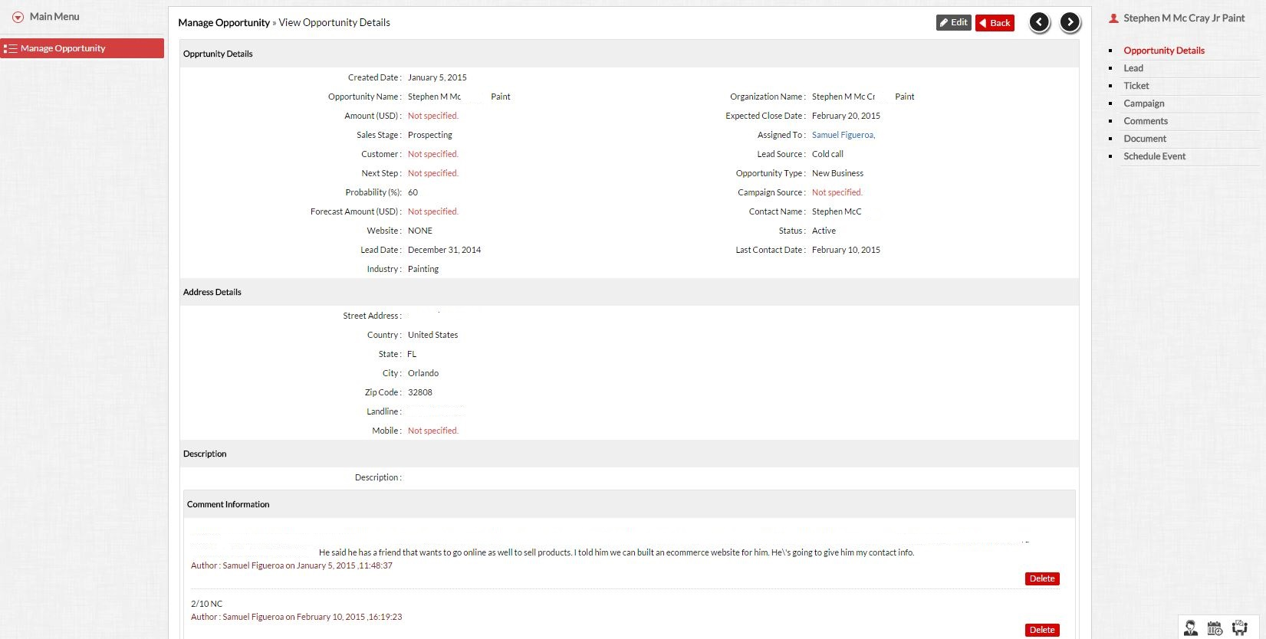
Opportunity
FOR TRAINING USE ONLY
Notes:
Every Opportunity starts out as a Lead. We name our Opportunities First Name, Last Name and Industry Type. In the example, your see a Stephen McCr and he is a painting company.

Slide 17
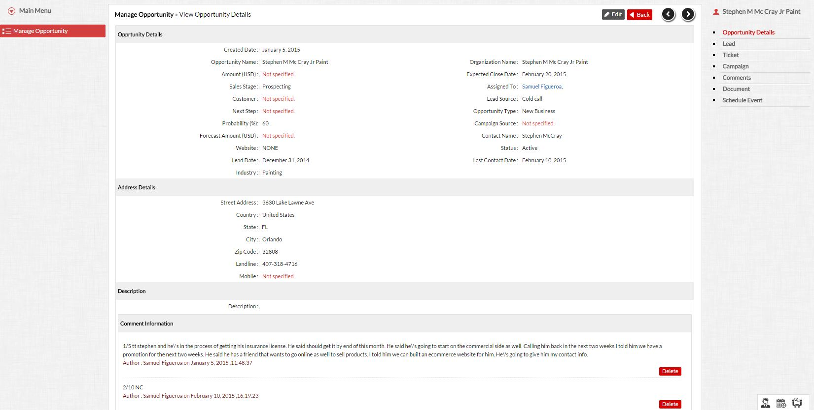
Opportunity
FOR TRAINING USE ONLY
Notes:
As with the Lead Module, you may add additional details such as ticket, comments , documents and Events.

Slide 18
Customer
An individual is considered a customer when he/she has a processed Sales Order in the ERP.
Notes:
In the final stage in the Sales Structure, an Opportunity is converted into a Customer. However, they must have a processed Sales Order top considered as such. After a successful process of a Sales Order, they are no longer considered an Opportunity ,so you have to input the necessary information in the Customer module. We will discuss the Sales Module later on.

Slide 19
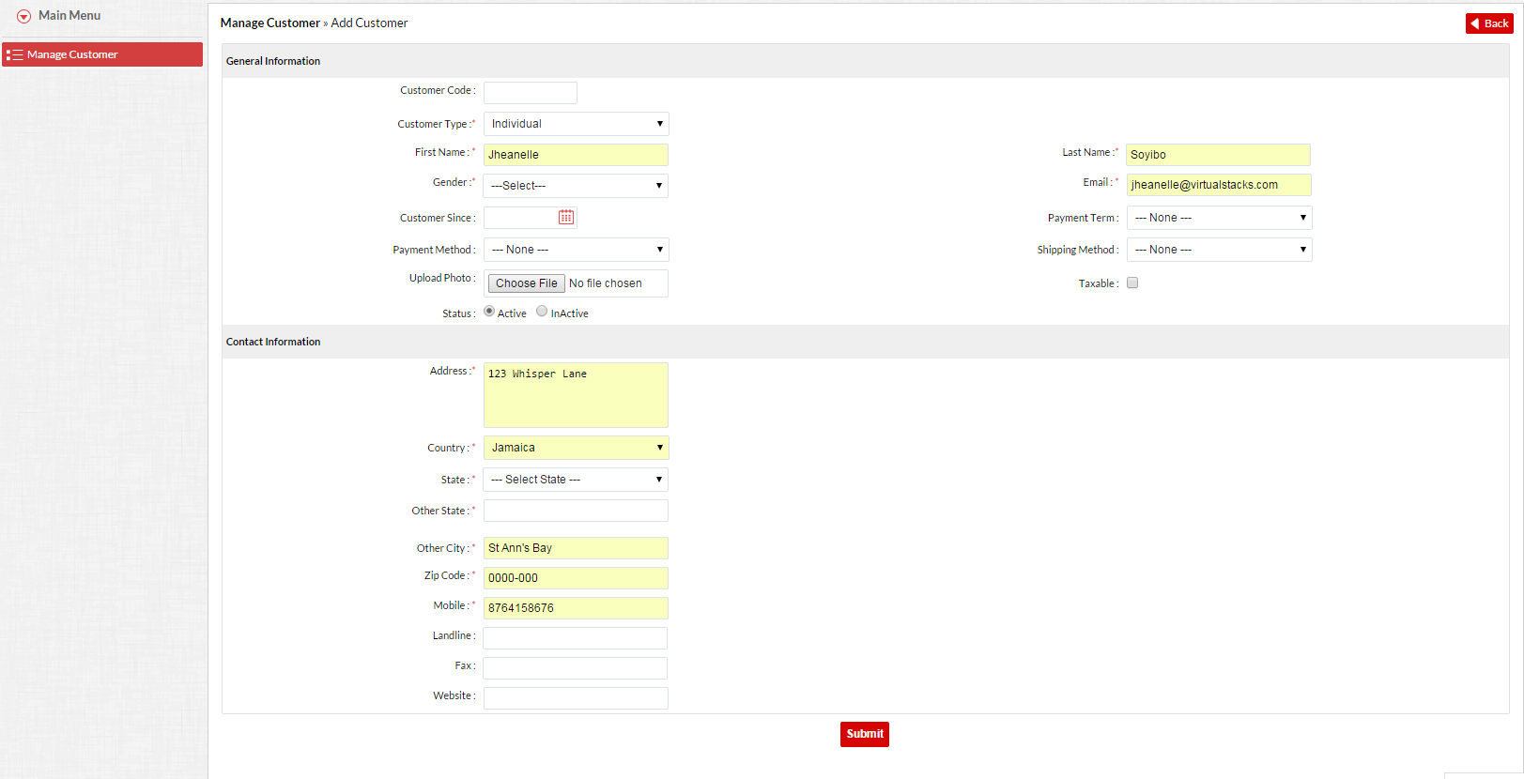
Customer
FOR TRAINING USE ONLY

Slide 20
Ticket
The ticket function streamlines organization- wide customer support processes. Integrating sales and post-sales support management and helps to resolve customer cases.
Notes:
Let say a customer put a down payment or paid in full for web design. A ticket is created for the individual in charge web design to inform them of a new client. The web designer edits the tickets and make note of the progress.

Slide 21
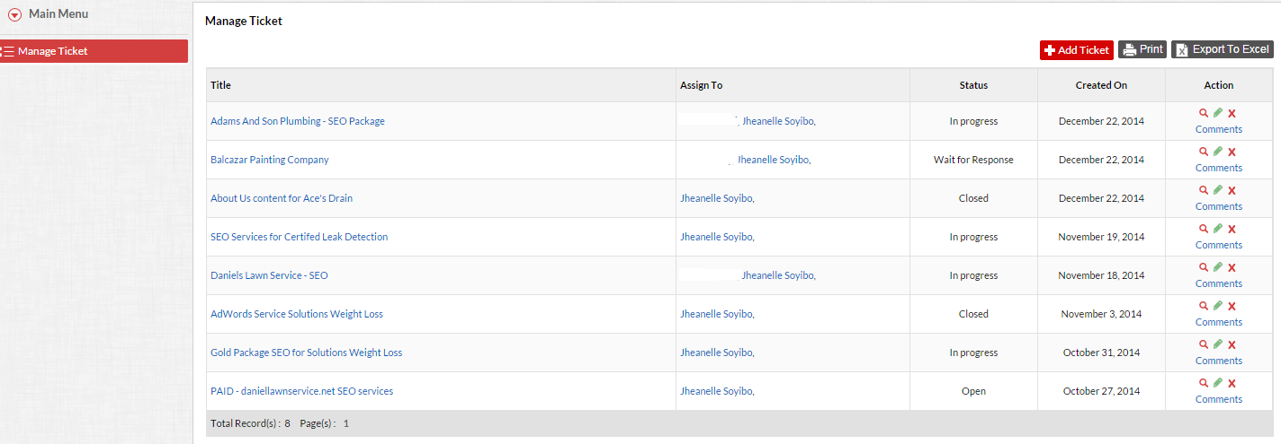
Ticket
FOR TRAINING USE ONLY
Notes:
Tickets are assigned to Supervisor, in this case would be Kevin, and then he will decide which individual receives a ticket for the service. The tickets have various statuses that are self explanatory. Tickets are closed when the issue has been resolved or you’re instructed to do so.

Slide 22
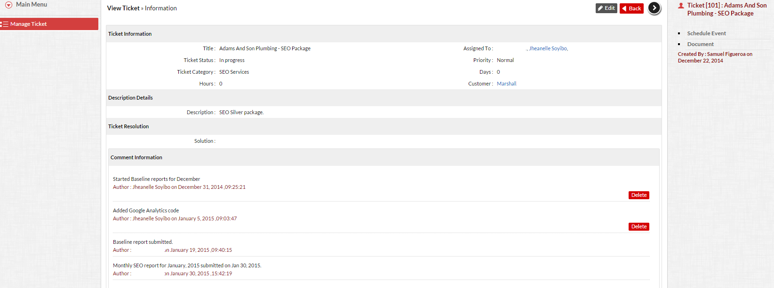
Ticket
FOR TRAINING USE ONLY
Notes:
When you edit or view a ticket in the ticket module, you can see on the right-hand side, you can schedule an event or document related to the Ticket.

Slide 23
Calendar
The ERP is equipped with a Calendar to keep you aware of appointments, tasks and events. You have the option to schedule for one occasion or on a recurring basis.
Notes:
It’s basic, anything you schedule within the modules, are located here. They can be viewed, edited or deleted.

Slide 24
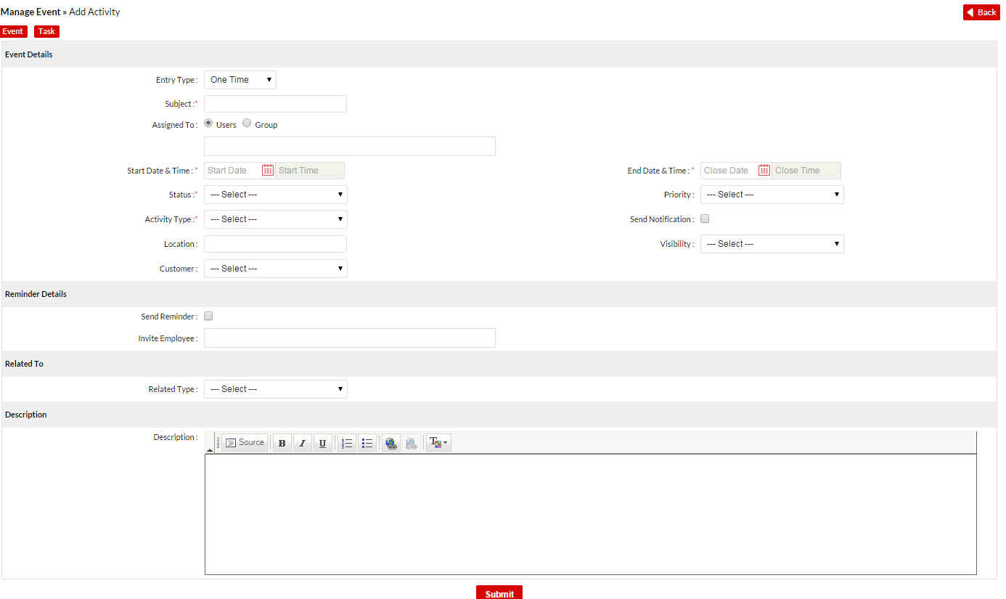
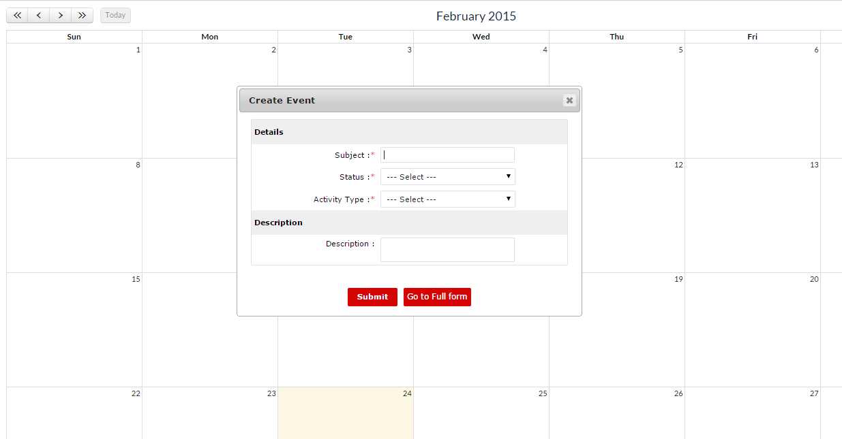
Calendar
FOR TRAINING USE ONLY
Notes:
To schedule a event/task in the Calendar, simple click inside the day you wish, and a Short Form will appear, where you would input your information. If you need to include more details of Event, you have the option to go to the full Form. You can choose, if you want to schedule a task or event and input all the information you need.

Slide 25
Quotes
Quotes are estimates. They are usually requested by the customer and is based on the cost of the items listed in the inventory.
Notes:
When a customer requests a quote, ensure that the prices and items are listed in the inventory prior to generating one.

Slide 26
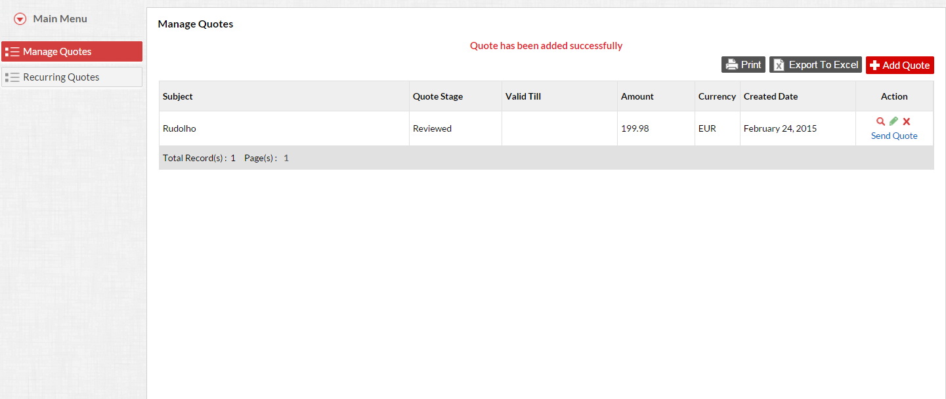
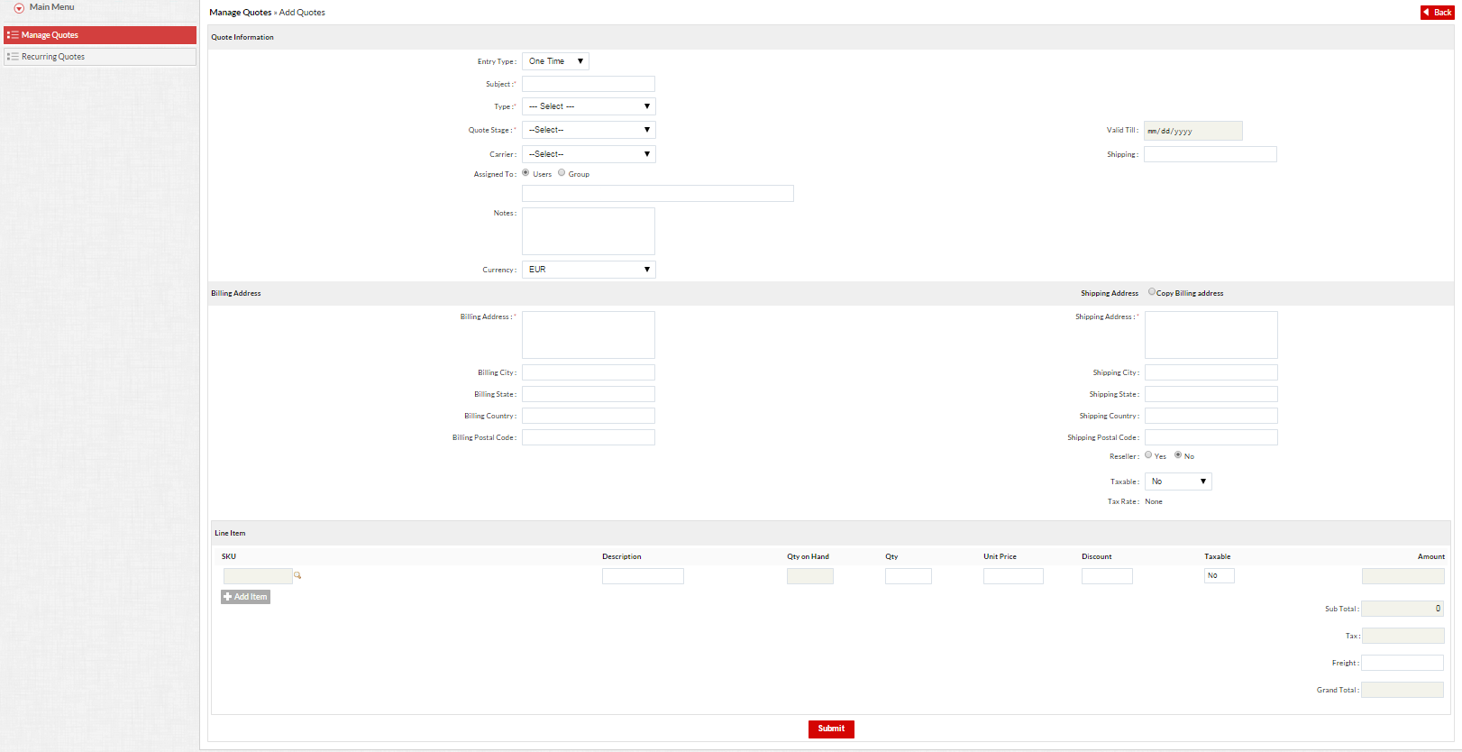
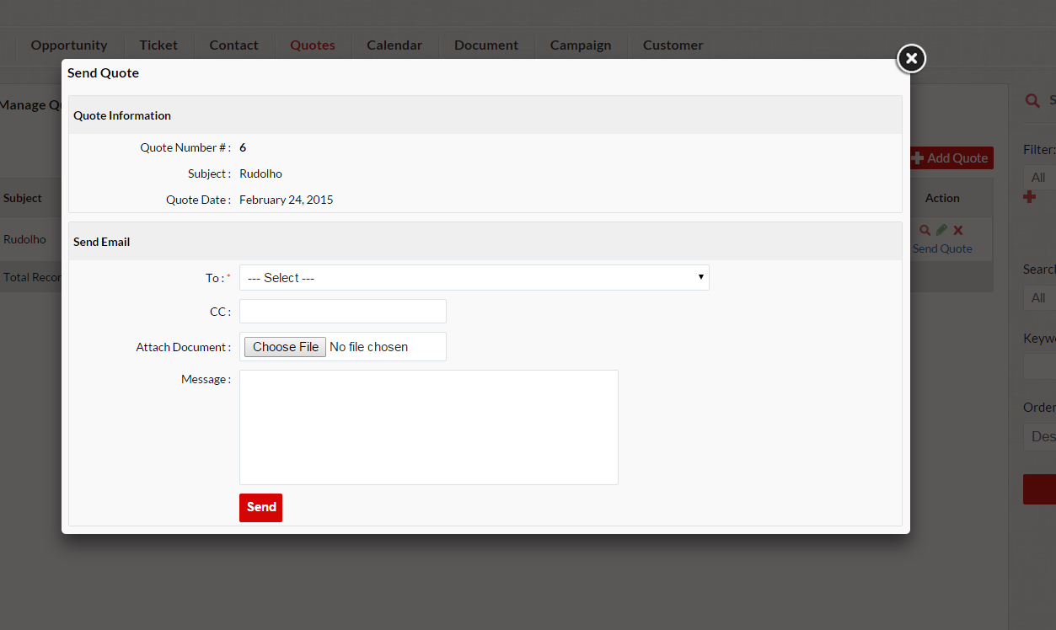
Quotes
FOR TRAINING USE ONLY
Notes:
To generate a quote input the necessary information and submit. After a successful input of information, you now have the access to send the quote to the customer. If an email address is listed then you will be able to locate the customer and CC anyone not listed as a contact or customer in the ERP
Note : A quote can be generated once or on a recurring basis.

Slide 27
Sales Module
Sales Quote
Sales Order

Slide 28
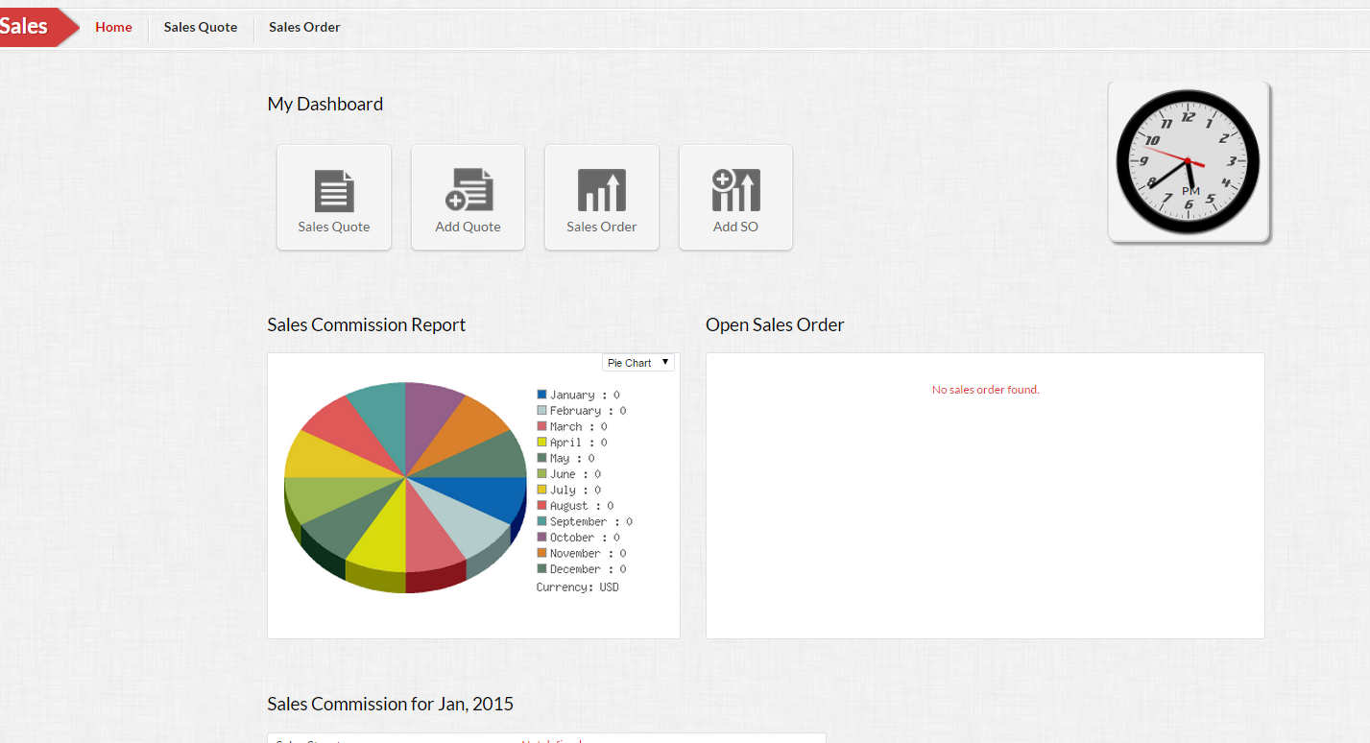
Sales Module
FOR TRAINING USE ONLY
Notes:
This the dashboard of the Sales Dashboard, it helps keep a track of your monthly commissions. They are two main modules Sales Quote and Sales Order. This is an imperative section of the CRM because this is how your commissions are calculated. If a Sales Order is not made for a customer, you will not receive payment.

Slide 29
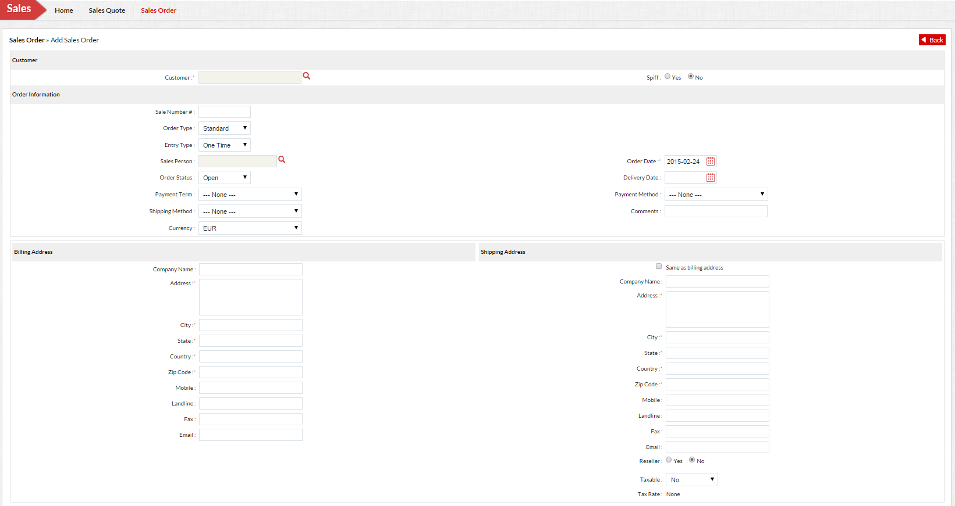
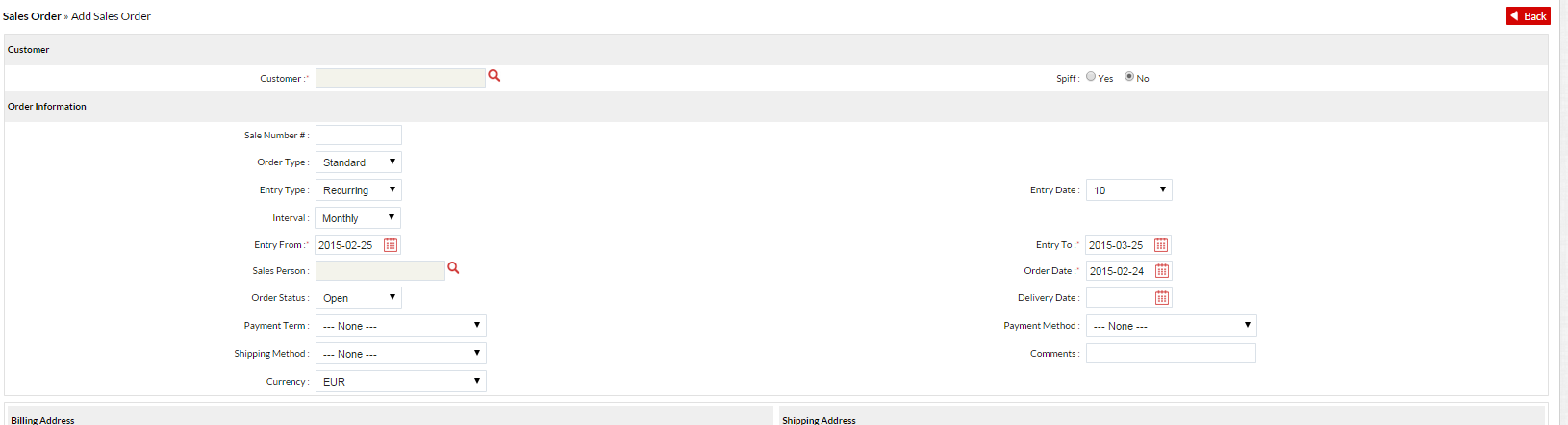
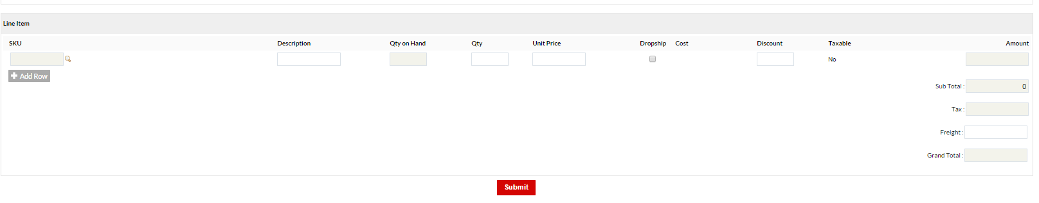
Sales Order
FOR TRAINING USE ONLY
Notes:
A Sales Order is made when the customer wants to purchase an item, after verification, an invoice is generated. The sales order is how you receive commission, please ensure that you do so after the customer has agreed to purchase the service.
This purchase can either be once or a recurring fee, check the intervals, most of our products are monthly, when you select monthly another fields should appear. These fields are Interval, Entry From,, Entry Date, Entry To, and Order Date.
Entry From -date in which the other is placed.
Entry Date – (this does not appear until you have input the Entry From Date) This the day when the recurring charge will take place.
Entry To – The end date of the recurring charge.
If you look at the top right of the screen you will notice the word Spiff, this is an incentive, but make sure that the selection NO is always selected, unless instructed to do so.

Slide 30
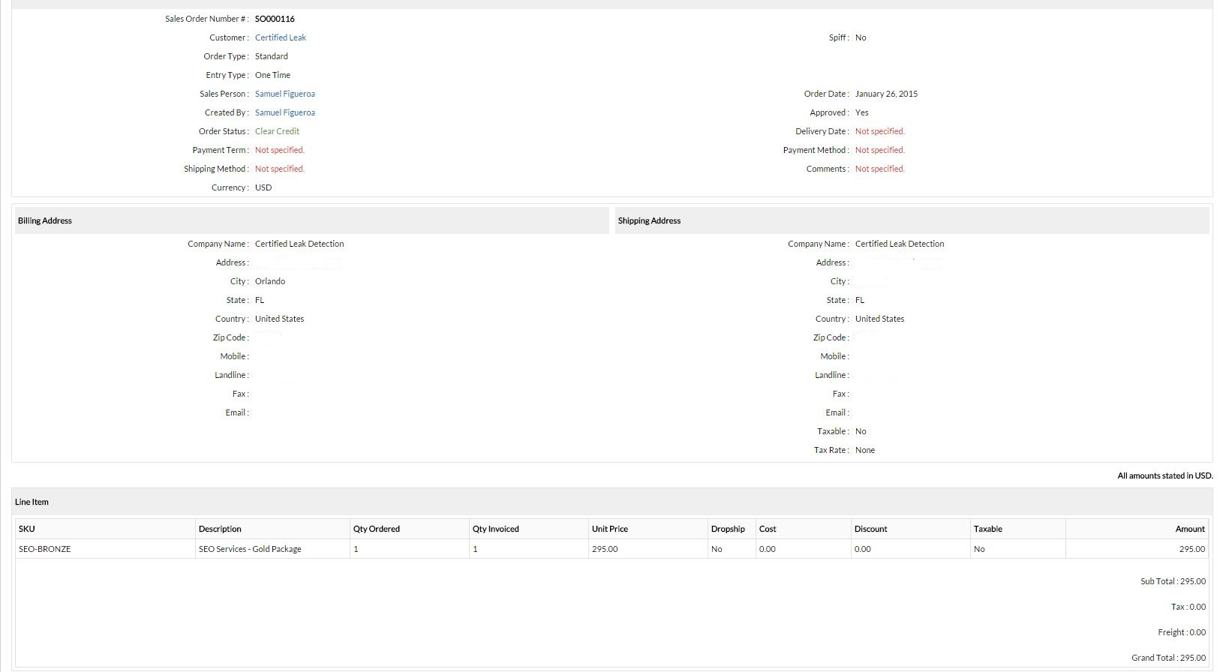
Sales Order
FOR TRAINING USE ONLY
Notes:
This is a complete Sales Od

Slide 31
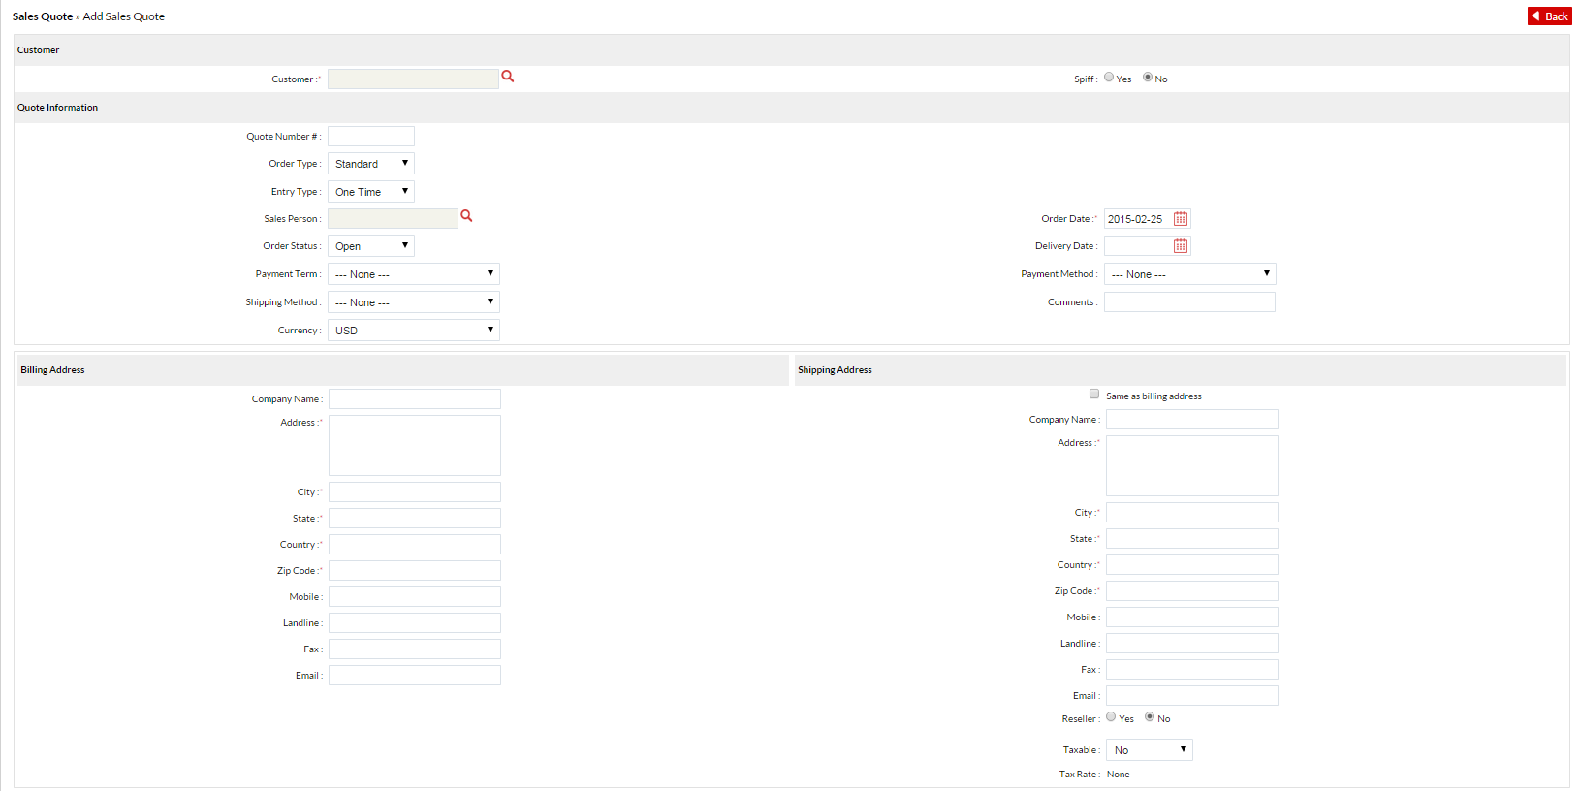
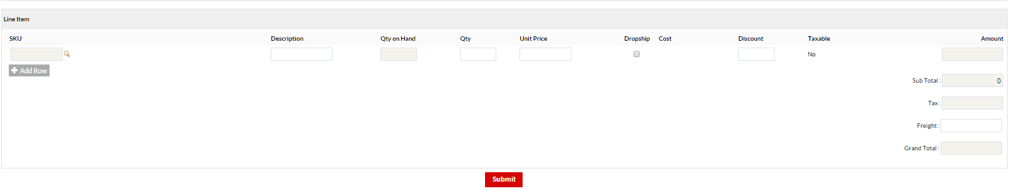
Sales Quote
Notes:
A sales quote is self explanatory, this is for existing customers only. When a Sales quote gets converted into a Sales Order, the quote disappears.

Slide 32

Questions?

